Slide 1

I DISTURBI NEUROPSICHIATRICI
NELLA MALATTIA DI PARKINSON
Dott.ssa Paola Ortelli,
Neuropsicologa, psicoterapeuta
Dipartimento di Riabilitazione Malattia di Parkinson e Gravi Cerebrolesioni Acquisite. Fresco Parkinson Centre, Ospedale «Moriggia-Pelascini» Gravedona ed Uniti (CO)

Slide 2

MALATTIA DI PARKINSON:
Malattia di Parkinson
FIRST ASSUMPTION
SINTOMI MOTORI
SINTOMI NON MOTORI
FOLLOWING ASSUMPTION

Slide 3








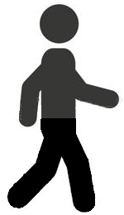

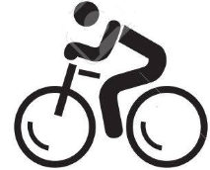

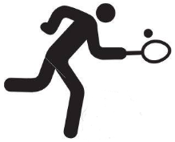
Dal movimento al comportamento motorio...
Specifiche sequenze di movimenti elementari innati
…Mouth and tongue
…Hands
…Arms
…Trunk
…legs
to play tennis
to talk
to drink
to eat
to write
to walk
to run
to cycle
… permettono di esprimere comportamenti motori appresi

Slide 4

Ho bisogno di…
Camminare lungo un corridoio
Fare le scale
…Arms
…Trunks
…legs
…Arms
…Trunks
…legs
to walk
to go upstair
DIFFICOLTOSO
CONSERVATO
Notes:
The movements you need to walk are the same as those you need to go upstair…. BUT often the first one action is impaired, the second one is not.
Why? Because the Parkinson disease affects the motor behavior, it affects the action and not specifically the movements.

Slide 5
Ho fame
Consapevolezza della necessità
attiva
Il SISTEMA MOTIVAZIONALE (o della gratificazione)
Che SPINGE il SISTEMA COGNITIVO
Ad attivare il corretto schema d’azione
to eat
…Mouth and tongue
…Hands
…Arms
…Trunks
È proprio il sistema cognitivo a sapere quale schema d’azione è da attivare in un preciso momento

Slide 6


PIANIFICAZIONE DELL’AZIONE:
Un compito di problem solving
Per selezionare la giusta scelta, devo valutare diversi aspetti:
Dove mi trovo?
Quanto tempo ho?
….
VADO AL RISTORANTE?
Per mettere in atto la mia scelta devo avere un corretto piano d’azione:
Scegliere il corretto logo dove recarmi (in cucina o al ristorante?)
Selezionare il cibo (aprire il frigorifero o leggere il menù)
….
O
to eat
MI CUCINO QUALCOSA A CASA?

Slide 7
… il PD è UN DISTURBO DEL COMPORTAMENTO MOTORIO
COMPORTAMENTO MOTORIO
SISTEMA MOTORIO
SISTEMA MOTIVAZIONALE
SISTEMA COGNITIVO
Notes:
In order to understand the study I’m going to talk about, I would to share with you our assumption about the Parkinson’s Disease and the nature of this neurodegenerative disorder.
First of all, Parkinson’s Disease is not a movement disorder, but a motor behaviour disorder.
The difference between movement and motor behaviour is crucial, not only because the movement could be thought as a single element of motor behaviour, but also because the motor behaviour is the final output of a complex network processing where the motivational input stresses the cognitive system to plan a problem-solving strategy, executed by motor system, through the movement.
Therefore, we have a lot of movement’s repertoires of specific body parts (image), underlying the motor cortex. The newborns yet have got these repertoires, being they innates. We were born being able to move our arms and our hands, but not before two years old, we learned how move them in order to bring a spoonful of food to our mouth.
The ability to plan a correct use of our movements in order to reach a goal is called “motor skill”; its acquisition is called “motor learning”; the final output is called “motor behaviour”. After being learned, every motor behaviour could be express automatically or voluntary, basis on the needs. The motor adaptation, that is the voluntary execution of a acquired motor behaviour, is a type of motor learning, sharing the same cortical-subcortical networks. We can say motor behaviour the final output of a complex network processing where the motivational input stresses the cognitive system to plan a problem-solving strategy, executed by motor system
Back to , Parkinson’s Disease involve three neural systems: the motivational, the cognitive and the motor ones.
Despite motor symptoms are

Slide 8
I GANGLI DELLA BASE sono le più important
STRUTTURE DI INTEGRAZIONE
Yelnik J, 2008
Notes:
In this fascinating model, based on the anatomical properties of the striatonigral and nigrostriatal (dopaminergic) pathways, the integrative properties of the basal ganglia have been considered. The dopaminergic pathways do not form closed independent loops, but rather provide ascending spiral connections between the sensorimotor, associative and limbic striatal subdivisions (Haber et al., 2000). Thus, from an anatomical point of view, the basal-ganglia system appears as a device that receives a sample of the three specific functional aspects of cortical information, sensorimotor, cognitive, emotional and that processes this information in a convergent manner. However, convergence is not the only aspect of basal-ganglia processing. A complex integration, in fact, takes place in each of the basal ganglia nuclei that results in the elaboration of a completely new and specific output message, that will be send to the frontal cortex. The role of the dopaminergic projection to striatal spiny neurons is thus to enable the learning of behavioral sequences under the motivational control of reward. As soon as, a behavioral sequence has been learnd and memorized in the basal ganglia circuit, it can be executed automatically without a permanent control of the cortex.
The striatum is, therefore, a structure which receives a compressed version of cortical information. Finally, the globus pallidus could be viewed as a keyboard on which various behavioral repertoires could be coded, from the simplest movement of a single joint - to the most complex motor sequences, involving the entire body and expressing an emotional content in a cognitive context. In order to better understand this aspect, you have to think about the movements of a dancer or a music player, which would involve a larger sample of neurons of the sensorimotor, associative and limbic territories. Thus, the output of the globus pallidus is a sort of holistic integration of different properties of behavior, just like the music represent a holistic input, being an experience of internal and external perceptions.

Slide 9
IL SISTEMA ORTOGONALE
Ferrazzoli et al, 2020

Slide 10
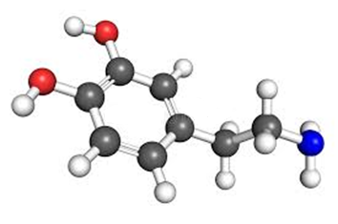
IL SISTEMA DOPAMINERGICO
MEDIA LA SELEZIONE DEL CORRETTO SCHEMA D’AZIONE
ABULIA
IPOTIMIA
ANEDONIA
SISTEMA MOTORIO
SISTEMA MOTIVAZIONALE
SISTEMA COGNITIVO
MEDIA LA SPINTA AD AGIRE PER SODDISFARE UN BISOGNO PERCEPITO
ATTIVA FUNZIONI COME IL PLANNING, IL PROBLEM SOLVING E L’ATTENZIONE
DEFICIT DI ATTENZIONE ESECUTIVA
MEDIA L’APPRENDIMENTO MOTORIO, DANDO UNA RISPOSTA IN TERMINI DI GRATIFICAZIONE AI COMPORTAMENTI CORRETTI
CONSERVATO

Slide 11
MOTOR BEHAVIOUR
BUT
MOTOR SYSTEM
MOTIVATIONAL SYSTEM
COGNITIVE SYSTEM
Notes:
In order to understand the study I’m going to talk about, I would to share with you our assumption about the Parkinson’s Disease and the nature of this neurodegenerative disorder.
First of all, Parkinson’s Disease is not a movement disorder, but a motor behaviour disorder.
The difference between movement and motor behaviour is crucial, not only because the movement could be thought as a single element of motor behaviour, but also because the motor behaviour is the final output of a complex network processing where the motivational input stresses the cognitive system to plan a problem-solving strategy, executed by motor system, through the movement.
Therefore, we have a lot of movement’s repertoires of specific body parts (image), underlying the motor cortex. The newborns yet have got these repertoires, being they innates. We were born being able to move our arms and our hands, but not before two years old, we learned how move them in order to bring a spoonful of food to our mouth.
The ability to plan a correct use of our movements in order to reach a goal is called “motor skill”; its acquisition is called “motor learning”; the final output is called “motor behaviour”. After being learned, every motor behaviour could be express automatically or voluntary, basis on the needs. The motor adaptation, that is the voluntary execution of a acquired motor behaviour, is a type of motor learning, sharing the same cortical-subcortical networks. We can say motor behaviour the final output of a complex network processing where the motivational input stresses the cognitive system to plan a problem-solving strategy, executed by motor system
Back to , Parkinson’s Disease involve three neural systems: the motivational, the cognitive and the motor ones.
Despite motor symptoms are

Slide 12
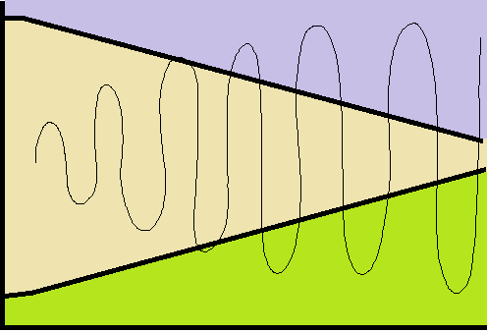
Dal 1960 è introdotta la TERAPIA DOPAMINERGICA
EFFETTI COLLATERALI motori, cognitivi e motivazionali DEL SOVRACCARICO DOPAMINERGICO
L-DOPA
STIMOLAZIONE PULSATILE
SINTOMI motori, cognitivi e motivazionali DELLA DEPLEZIONE DOPAMINERGICA
DISEASE DURATION
Notes:
Treatment of Parkinson’s disease aims to replace dopaminergic transmission at cortico-striatal networks. In the normal state, nigral neurons fire continuously, exposing striatal dopamine receptors to relatively constant levels of dopamine. In the disease state, periodic dosing and the short half-life of antiparkinsonian drugs leads to more intermittent stimulation. Abnormal pulsatile stimulation of striatal dopamine receptors may lead to dysregulation of genes and proteins in downstream neurons and consequently, alterations in neuronal firing patterns. This may ultimately lead to side effects

Slide 13
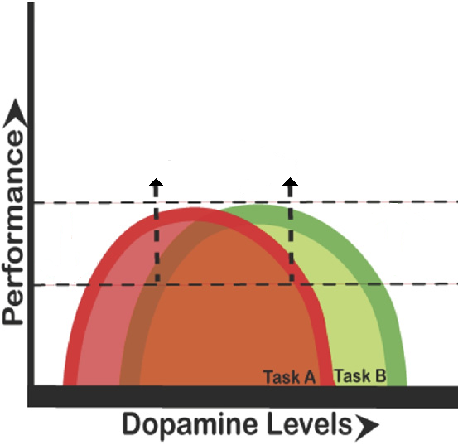
Adapted from Cools R. Neurosci Biobehav Rev 2006
ATTENZIONE ESECUTIVA
FLESSIBILITA’ E PIANIFICAZIONE
APPRENDIMENTO MOTORIO
APPRENDIMENTO TRAMITE REWARD
OFF STATE
ON STATE
ATTENZIONE ESECUTIVA
FLESSIBILITA’ E PIANIFICAZIONE
APPRENDIMENTO MOTORIO
APPRENDIMENTO TRAMITE REWARD
PROGRESSIONE DELLA DELPLEZIONE DOPAMINERGICA E SINTOMI DEL PD
ECCESSO DI DOPAMINA ED EFFETTI COLLATERALI COGNITIVI
Notes:
This condition generate a new cìsyndrome where symptoms

Slide 14
PD: ECCESSO DI DOPAMINA
PAZIENTE IN BUON COMPENSO FARMACOLOGICO
PD: DEPLEZIONE DOPAMINERGICA
Raul Martınez-Fernandez, 2016

